Slide 1
WEEK 21
Multiple Linear Regression (II)

Slide 2
Lecture outline
F-test for model significance
t-test for parameter significance
Model selection: stepwise selection

Slide 3
Testing for Significance
In simple linear regression, the F and t tests provide
the same conclusion.
In multiple regression, the F and t tests have different
purposes.

Slide 4
Testing for Significance: F-test
The F test is used to determine whether a significant
relationship exists between the dependent variable
and the set of all the independent variables.
The F test is referred to as the test for overall
significance.

Slide 5
Testing for Significance: F-test
H₀: β₁ = β₂ = . . . = β_{k} = 0
H_{a}: At least one of the parameters (betas) is not equal to zero.
Hypotheses
Test Statistics
F = MSR/MSE
Rejection Rule
Reject H₀ if p-value < α or if F > F_{α}
where F_{α} is based on an F distribution
with k d.f. in the numerator and
n - k - 1 d.f. in the denominator.

Slide 6

Example
This exercise uses Rankings dataset. The Times Higher Education provides an annual ranking of the world universities. The rankings data set is a random sample of universities from 3 countries: US, UK and Germany
Variables used:
Overall Score – dependent variable
Peer Review
Country
Faculty-to-Student Ratio
Citations-to-Faculty Ratio
Recruiter Review
Percent International Faculty
Percent International Student

Slide 7
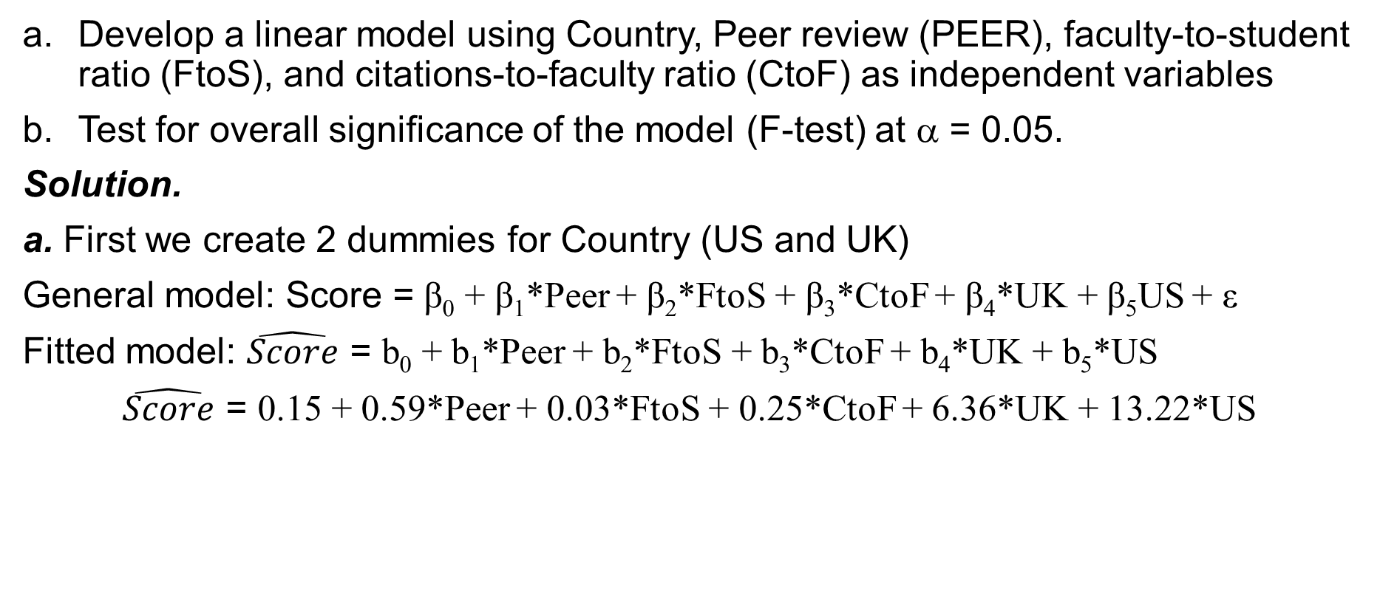
Example
Develop a linear model using Country, Peer review (PEER), faculty-to-student ratio (FtoS), and citations-to-faculty ratio (CtoF) as independent variables
Test for overall significance of the model (F-test) at α = 0.05.
Solution.
a. First we create 2 dummies for Country (US and UK)
General model: Score = β₀ + β₁*Peer + β₂*FtoS + β₃*CtoF + β₄*UK + β₅US + ε
Fitted model: $\hat{Score}$ = b₀ + b₁*Peer + b₂*FtoS + b₃*CtoF + b₄*UK + b₅*US
$\hat{Score}$ = 0.15 + 0.59*Peer + 0.03*FtoS + 0.25*CtoF + 6.36*UK + 13.22*US
 | Intercept | US | UK | PEER | FtoS | CtoF
Coefficients | 0.152 | 13.222 | 6.356 | 0.592 | 0.032 | 0.252

Slide 8
Example
b. F-test is used for overall significance
H₀: β₁= β₂ = β₃= β₄= β₅ = 0
H_{a}: At least one of the betas is not equal to 0.
ANOVA
 | df | SS | MS | F | Significance F
Regression | 5 | 6204.725 | 1240.945 | 40.80867 | 1.68201E-11
Residual | 26 | 790.6302 | 30.40885
Total | 31 | 6995.355
p-value for F-test
=1.68*10⁻¹¹= 0.000…
Since p-value = 0.000… < 0.05, we reject H₀, and conclude that overall model is significant in predicting the ranking of the University.

Slide 9
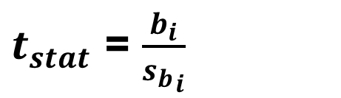
Testing for Significance: t-test
H₀: β_{i} = 0
H_{a}: β_{i} ≠ 0
Hypotheses
Test Statistics
$t_{stat}$ = $\frac{b_{i}}{{s_{b}}_{i}}$
Reject H₀ if p-value < α or
if |t| > t_{α/2} where t_{α/2}
is based on a t distribution
with n - k - 1 degrees of freedom.
Rejection Rule

Slide 10
Example
Refer to the linear model developed in previous example.
Score = β₀ + β₁*Peer + β₂*FtoS + β₃*CtoF + β₄*UK + β₅US + ε
Test whether each independent quantitative variable has significant linear relationship with score. Use α = 0.05
Peer: FtoS: CtoF:
H₀: β₁ = 0 H₀: β₂ = 0 H₀: β₃ = 0
H_{a}: β₁ ≠ 0 H_{a}: β₂ ≠ 0 H_{a}: β₃ ≠ 0
p-value = 0.00… p-value = 0.52 p-value = 0.00…
Reject H0 fail to reject H0 Reject H0
Peer and CtoF variables have significant linear relationships with Score.
Faculty-to-Student ratio has no significant linear relationship with Score.

Slide 11
Model Selection: selecting “best” model
There are various methods for model selection with different criterions.
We will cover only stepwise selection with backward elimination using p-value criterion.
Steps of selecting the “best” model.
Step 1. Run regression using all independent variables.
Step 2. Remove only one variable with the highest p-value.
Step 3. Rerun the regression. Continue until all independent variables are significant.
Note: You cannot remove one level of categorical variable if that is not significant. You either remove all at once or keep them all in the model. As long as one of the dummy variables is significant they all should be in the model.

Slide 12




Example : “Best” model for predicting movie revenue
38 random movies were selected to develop a model for predicting their revenues.
We have the following variables in the dataset:
USRevenue – movie’s revenue in the US (mln $)
Rating – restrictions based on age (PG, PG-13, R)
Budget – budget (expenditure) of the movie (mln $)
Opening – revenue on the opening weekend (mln$)
Theaters – number of theaters the movie was in for the opening weekend
Opinion – IMDb rating (1 to 10, 10 being the best)

Slide 13
USRevenue = β₀ + β₁*Budget + β₂*Opening + β₃*Theaters + β₄*Opinion + β₅PG + β₅R + ε
Step 1. Run Regression including all variables (α = 0.05):
Step 2. Rerun regression without Budget variable:
 | Coefficients | P-value
Intercept | -587.622 | 0.003
Budget | 0.161 | 0.787
Opening | 1.584 | 0.043
Theaters | 0.086 | 0.013
Opinion | 61.354 | 0.014
PG | -120.303 | 0.172
R | 49.822 | 0.397
Remove the variable with the highest p-value
 | Coefficients | P-value
Intercept | -589.550 | 0.002
Opening | 1.716 | 0.005
Theaters | 0.086 | 0.012
Opinion | 63.040 | 0.008
PG | -117.216 | 0.173
R | 44.483 | 0.414
Since, none of the dummies for rating are significant, we remove both at the same time.

Slide 14
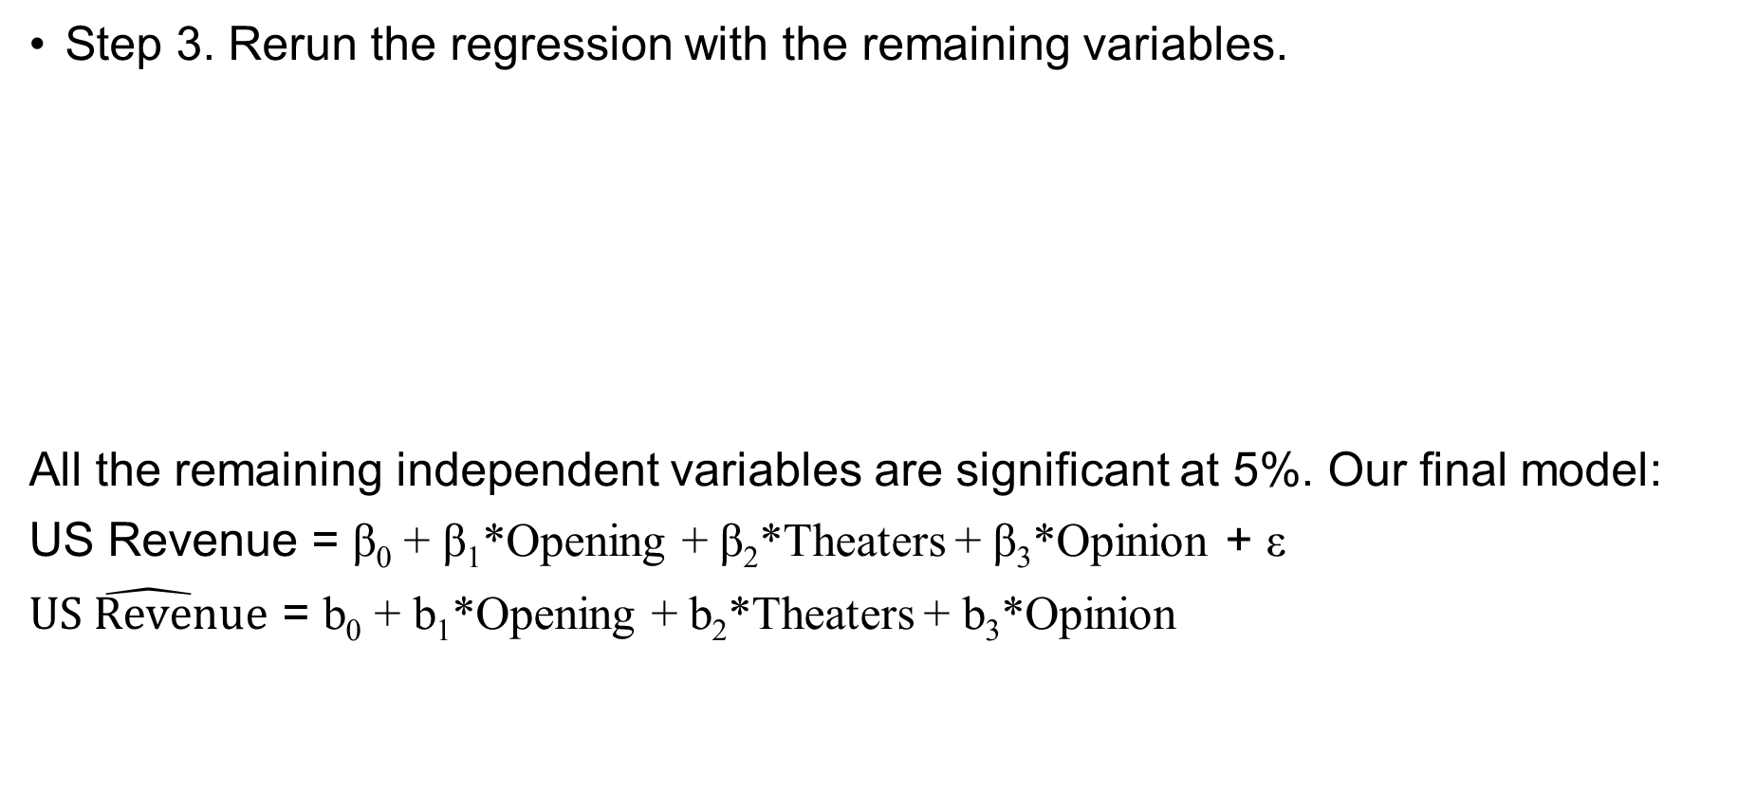
Step 3. Rerun the regression with the remaining variables.
All the remaining independent variables are significant at 5%. Our final model:
US Revenue = β₀ + β₁*Opening + β₂*Theaters + β₃*Opinion + ε
$\hat{US Revenue}$ = b₀ + b₁*Opening + b₂*Theaters + b₃*Opinion
 | Coefficients | P-value
Intercept | -482.6413 | 0.0075
Opening | 1.9484 | 0.0012
Theaters | 0.0595 | 0.0495
Opinion | 58.0877 | 0.0140

Slide 15
THE END
Thank you for your attention!

